Slide 1
Vaidani LAKSHMI VIJAYA
Micro IT Project
AI Chatbot for FAQs

Slide 2
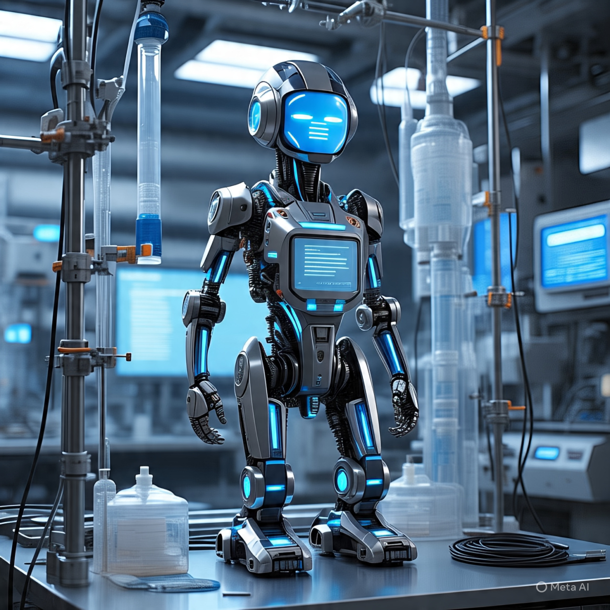
Introduction
I developed a smart FAQ chatbot using Dialogflow Essentials, focusing on answering internship-related queries in a natural and interactive manner. The agent was carefully designed with intents, training phrases, and responses to cover a wide range of common questions. Once trained and tested, the chatbot was seamlessly integrated into a custom webpage using the Dialogflow Messenger script. The final interface includes styled content, images, and a user-friendly layout to ensure smooth communication and accessibility for users.

Slide 3
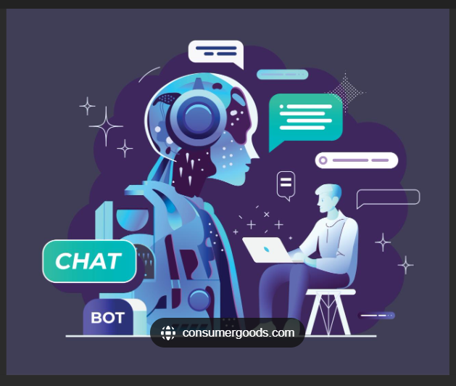
Problem statement
Students often struggle to find accurate and quick answers to common questions about internships, such as available roles, application steps, and duration. Manual support through emails or staff can be slow and inconsistent. This results in confusion, missed opportunities, and delays in applying. There's a clear need for an automated solution. An AI-powered chatbot can bridge this communication gap efficiently.

Slide 4
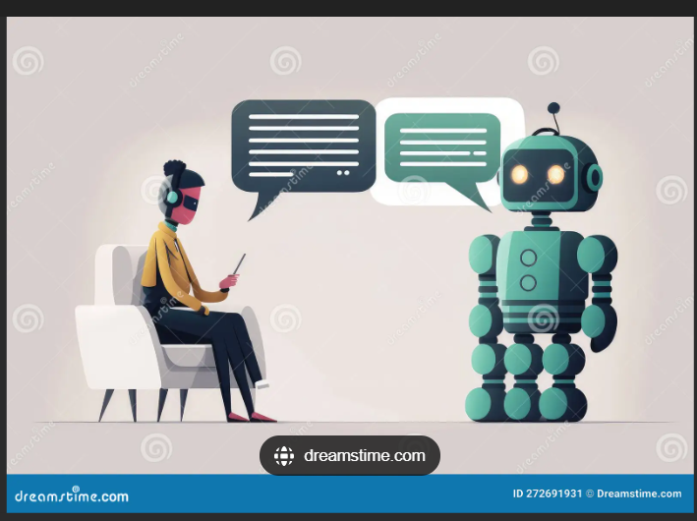
objectives
Build a user-friendly chatbot that:
Answers common internship-related FAQs
Provides company-specific internship info
Offers real-time, interactive responses
Make it accessible via a website.

Slide 5
Tools and Technologies
💬 Dialogflow ES – For natural language processing
🌐 HTML & CSS – For webpage design
📄 CSV file – For internship question-answer pairs
🖼️ Images – For UI enhancement
🔍 Live Server – To run and preview locally

Slide 6
Creating the CSV File
Structured CSV with two columns:
Question
Answer
Covered various companies: Infosys, Google, Cisco, etc.
Sample questions:
"How long is Infosys internship?"
"Which companies offer AI internships?"

Slide 7
Development Steps – Part 1
Dialogflow Setup
Created agent: InternshipFAQChatBot
Enabled beta features and added knowledge base
Uploaded CSV file with FAQ data

Slide 8
Development Steps – Part 2
Intent & Knowledge Connector
Created WELCOME intent
Enabled knowledge base responses using $Knowledge.Answer
Set up fallback and default responses

Slide 9
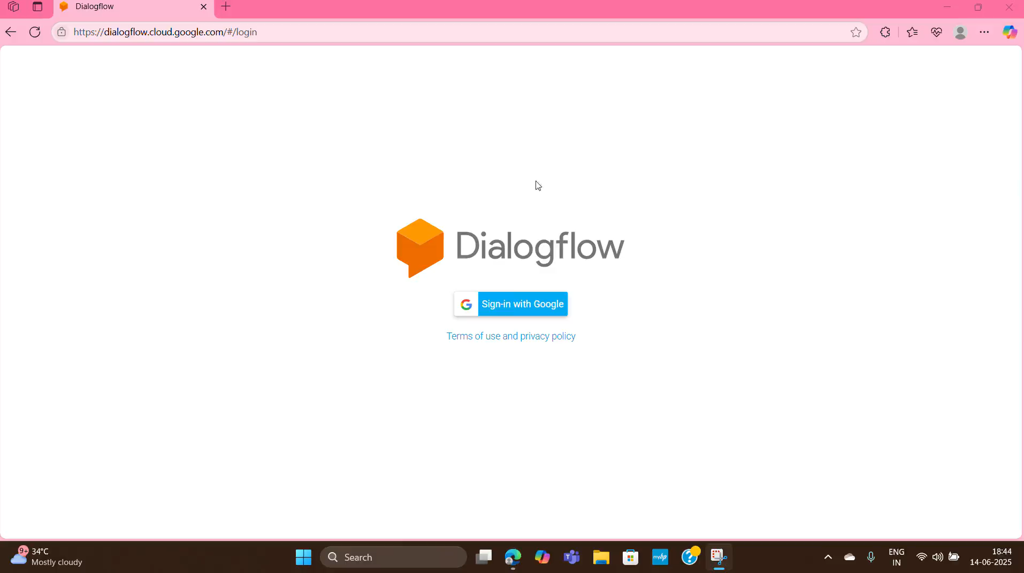
AICHATBOT WEBSITE DEVELOPMENT USING DIALOG FLOW ESSENTIALS video OPEN IN POWERPOINT PRESENTATION MODE FOR SEEING VIDEO

Slide 10
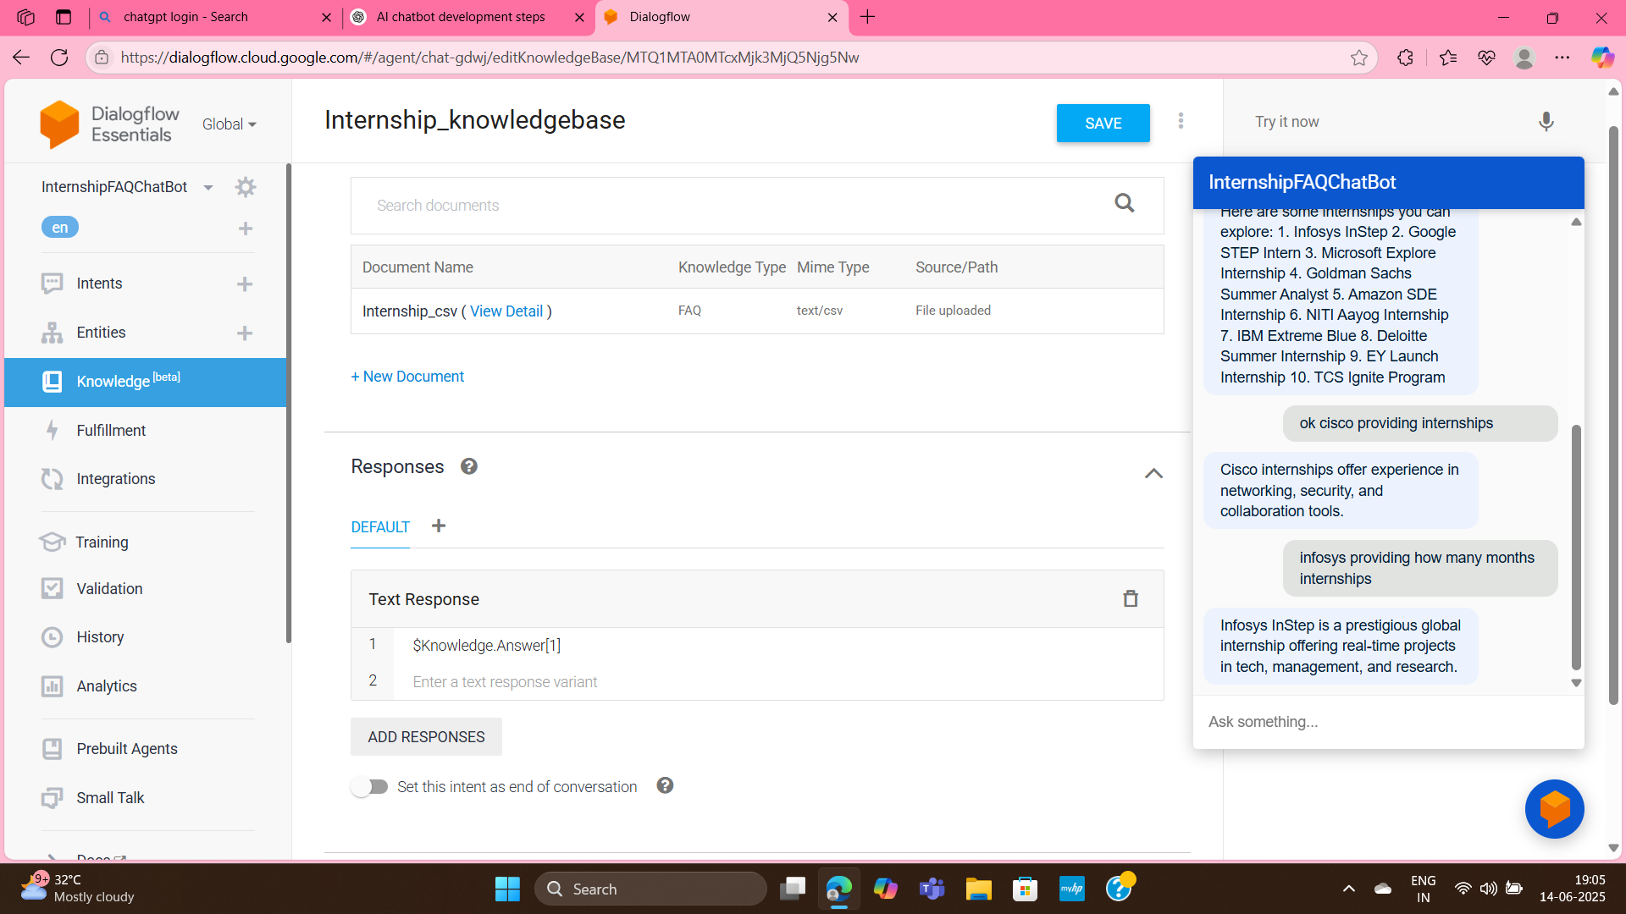
Development chatbot image

Slide 11
Web Integration
Used <df-messenger> script from Dialogflow
Added chatbot widget to HTML
Customized title and agent ID
Enabled live preview using Live Server

Slide 12
Web Page Design
Used HTML & CSS for layout
Added two images:
AI Chatbot representation
Students using computers
Applied styles:
Background: Light green
Titles: Center-aligned, red color
Clean layout with images on the left

Slide 13
Final Web Page Overview
Chatbot appears on the right side
Beautiful header: “AI ChatBot For Internship Details”
Subheader: “Providing Internship Details for Students”
Background and images enhance visual appeal

Slide 14
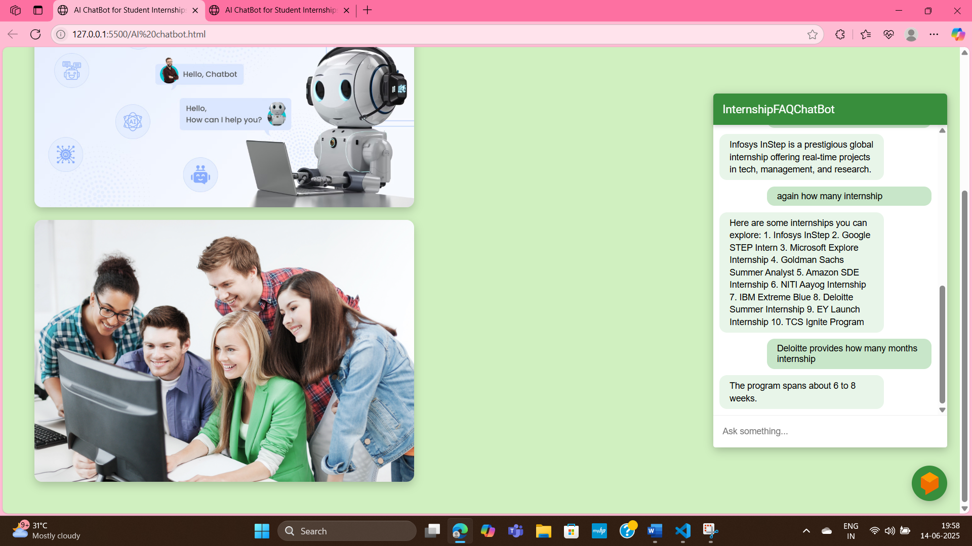
Final AICHATBOT website image

Slide 15
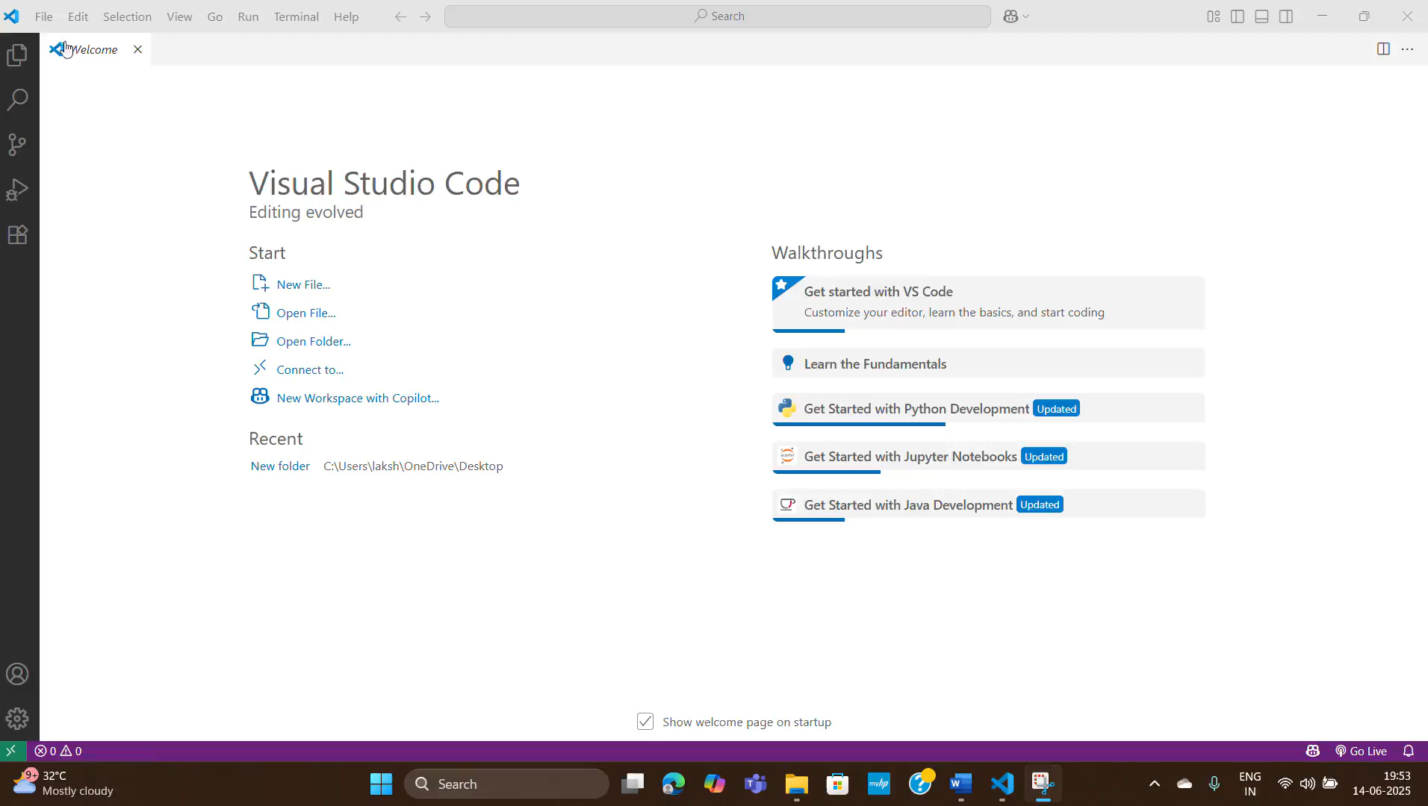
ChatBOT WEBSITE VIDEO OPEN IN POWERPOINT PRESENTATION MODE FOR SEEING VIDEO

Slide 16
Dialogflow Messenger embed code
<script src="https://www.gstatic.com/dialogflow-console/fast/messenger/bootstrap.js?v=1"></script>
<!-- Dialogflow Messenger Web Component -->
<df-messenger
intent="WELCOME"
chat-title="InternshipFAQChatBot"
agent-id="85e6887e-9ea0-4356-86dc-f7f6dfdd1d2f"
language-code="en"
></df-messenger>

Slide 17
Conclusion & Future Work
Successfully created a fully functional internship FAQ chatbot
Integrated seamlessly into a web interface
Future Work:
Host it publicly using GitHub Pages
Add live database integration
Enable multilingual support

Slide 18
AI CHATBOT FOR FAQS WEBSITE URL
http://127.0.0.1:5500/AI%20chatbot.html

Slide 19
THANK YOU

